Slide 1

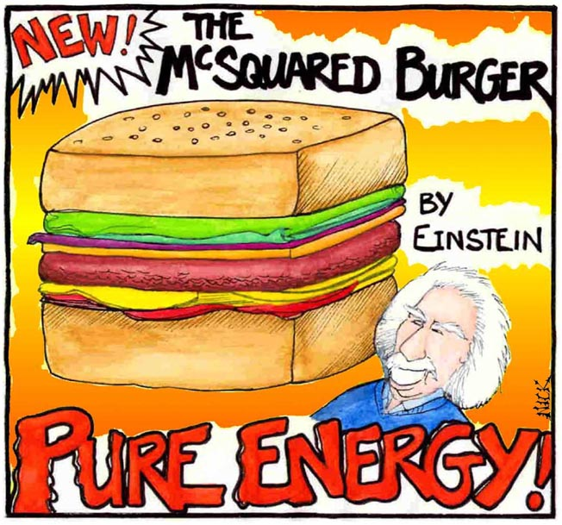
Special Relativity Calculations 4 Cant keep up the momentum?

Slide 2

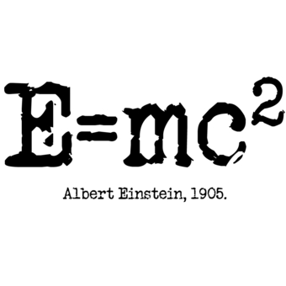
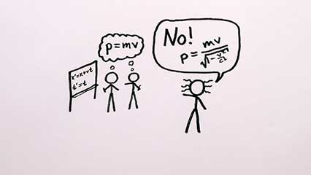
Special Relativity Review
Time Dilation Review
Length Contraction Review
Relativistic Velocity Addition
Relativistic Momentum and Energy

Slide 3
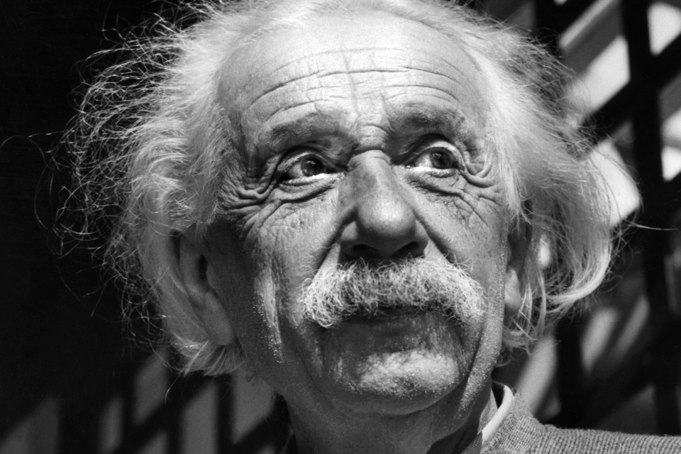
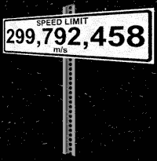
Two Postulates of Special Relativity
Einstein’s Special Theory of Relativity, published in 1905, was based on two postulates:
I. The laws of physics are the same for all frames of reference moving at a constant velocity with respect to each other.
II. The velocity of light in a vacuum c is constant for all observers, independent of their state of motion. (c = 3.00 x 10⁸ ms⁻¹)

Slide 4
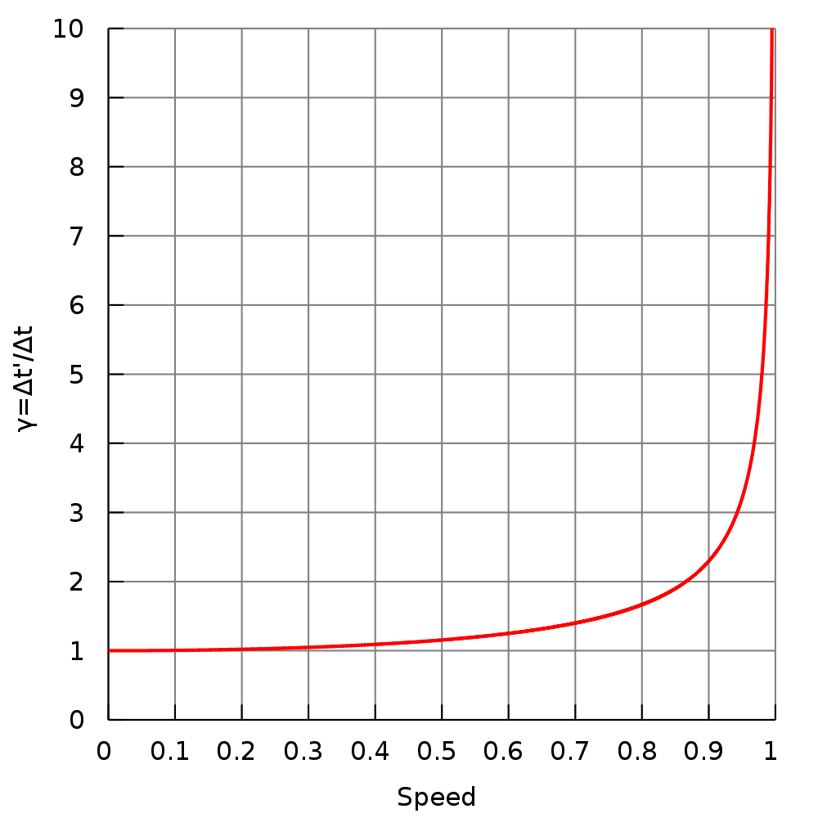
Time Dilation Review
Time measured for an event in a moving frame will be greater than the actual time for the event inside that frame, if measured from a reference outside the moving frame of reference.
In other words, time appears to go slower inside a moving frame when viewed from outside that frame.

Slide 5

Length and Distance Contraction
One of the other effects of relativistic speeds is that lengths are shorter when measured from a different inertial reference frame.
We call this length contraction.

Slide 6
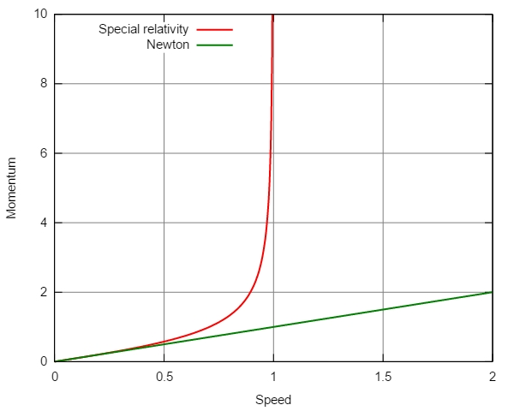
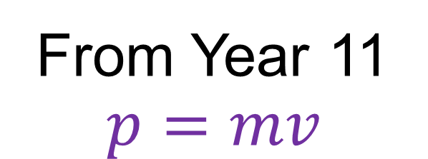
Newtonian Momentum vs Einstein
From Year 11
$$p=mv$$
Why?

Slide 7
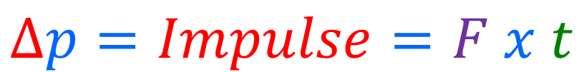
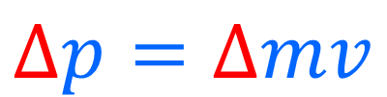
Newtonian Momentum vs Einstein
From Year 11
$$∆p=∆mv$$
$$∆p=Impulse=F x t$$
Time is a Factor when Momentum Changes
But time is a variable that is altered by relativistic velocities

Slide 8
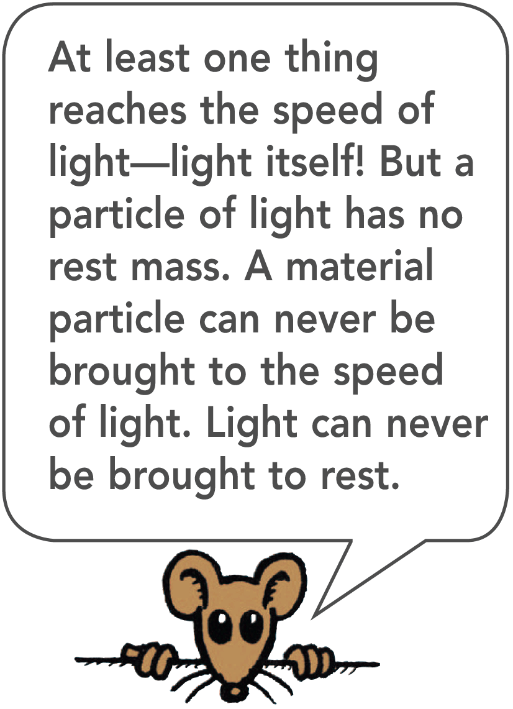
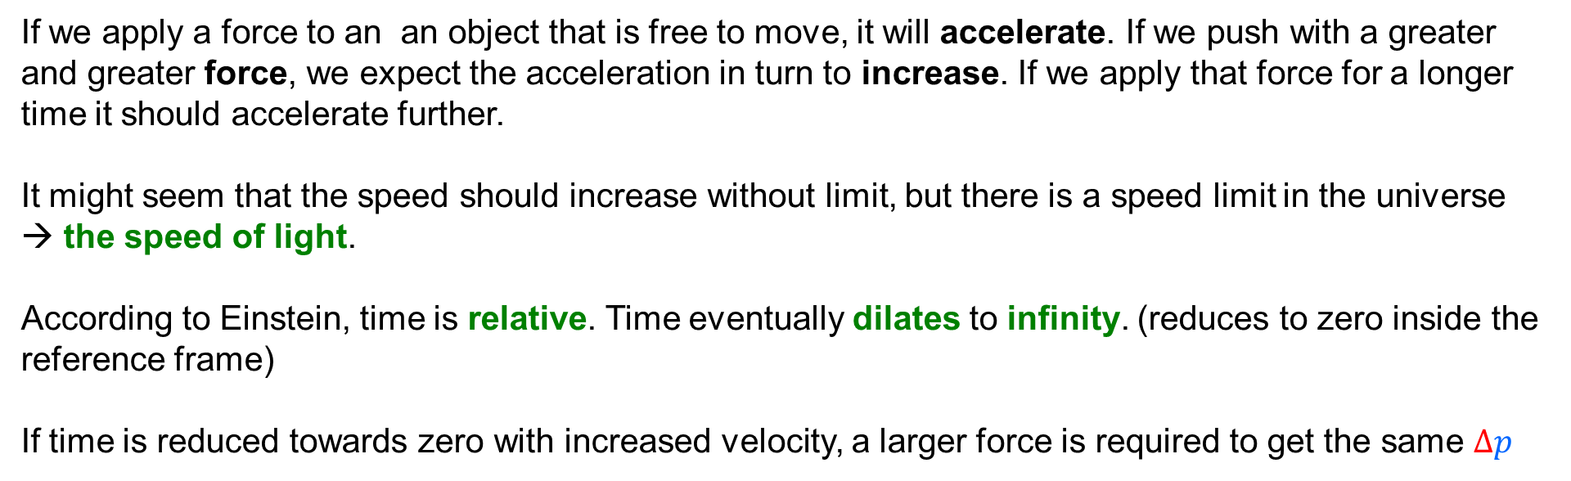
Newtonian Momentum vs Einstein
From Year 11
$$∆p=∆mv$$
$$∆p=Impulse=F x t$$
If we apply a force to an an object that is free to move, it will accelerate. If we push with a greater and greater force, we expect the acceleration in turn to increase. If we apply that force for a longer time it should accelerate further.
It might seem that the speed should increase without limit, but there is a speed limit in the universe
→ the speed of light.
According to Einstein, time is relative. Time eventually dilates to infinity. (reduces to zero inside the reference frame)
If time is reduced towards zero with increased velocity, a larger force is required to get the same $∆p$

Slide 9
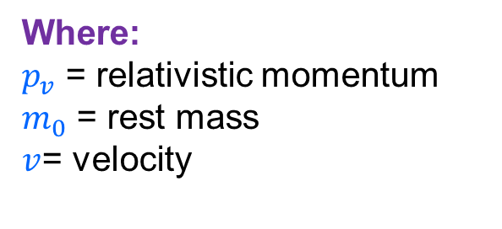

Momentum and Inertia in Relativity
To Newton, infinite momentum would mean infinite speed.
Einstein showed that a new definition of momentum is required:
This is relativistic momentum, which is noticeable at speeds approaching the speed of light.
$$p_{v}=\frac{m_{0}v}{\sqrt{1−\frac{v^{2}}{c^{2}}}}$$
Where:
$p_{v}$ = relativistic momentum
$m_{0}$ = rest mass
$v$= velocity
As v approaches c, the denominator approaches zero. This means that the momentum approaches infinity!
An object pushed to the speed of light would have infinite momentum and would require an infinite impulse, which is clearly impossible.

Slide 10
Momentum and Inertia in Relativity
To Newton, infinite momentum would mean infinite speed.
Einstein showed that a new definition of momentum is required:
This is relativistic momentum, which is noticeable at speeds approaching the speed of light.
$$p_{v}=\frac{m_{0}v}{\sqrt{1−\frac{v^{2}}{c^{2}}}}$$
Where:
$p_{v}$ = relativistic momentum
$m_{0}$ = rest mass
$v$= velocity
So nothing that has mass can be pushed to the speed of light.
Hence c is the speed limit in the universe.
If v is much less than c, the denominator above is nearly equal to 1 and p is nearly equal to mv.
Thus, Newton’s definition of momentum is still valid at low speed.

Slide 11

Relative Momentum and Mass
If relative momentum is much greater than Newtonian momentum for any given velocity, this then has implications for mass.
$$Relative Momentum≫ Newtonian Momentum$$
Where:
$p_{v}$ = relativistic momentum
$m_{0}$ = rest mass
$v$= velocity
$$p_{v}=m_{v}v ≫ m_{0}v$$
If the velocities are the same, then the mass of the body must be increasing!

Slide 12
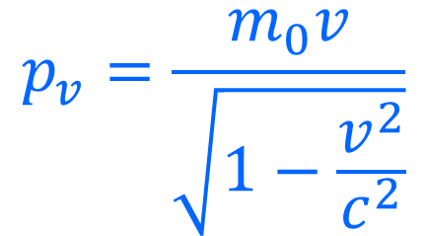
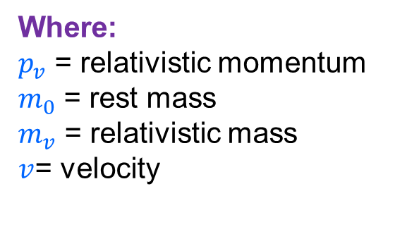


Relative Momentum and Mass
Einstein had an equation for relative mass as below:
We simply cancel the velocities on each side to get an equation that only shows mass.
You will see that it is in the same format as time dilation, so we say that mass is dilated.
$$p_{v}=\frac{m_{0}v}{\sqrt{1−\frac{v^{2}}{c^{2}}}}$$
$$m_{v}v=\frac{m_{0}v}{\sqrt{1−\frac{v^{2}}{c^{2}}}}$$
Where:
$p_{v}$ = relativistic momentum
$m_{0}$ = rest mass
$m_{v}$ = relativistic mass
$v$= velocity
NOTE – This formula does not appear on your data sheet because it is a simple cancelation as shown.
$$m_{v}=\frac{m_{0}}{\sqrt{1−\frac{v^{2}}{c^{2}}}}$$

Slide 13
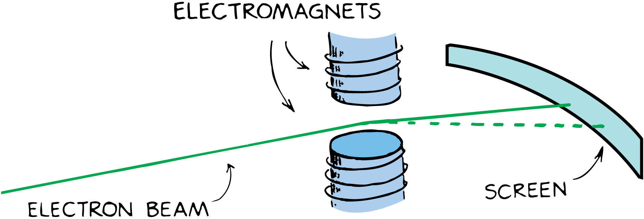
Relative Momentum and Inertia – The Evidence
As with all of Einstein's work, Physicists didn’t just accept the proposals at face value. Each of his ideas have been vigorously tested.
Deviation of high speed particles in magnetic fields is one area that Einstein's ideas have been supported by empirical evidence.
If the momentum of the electrons were equal to the Newtonian value of momentum, mv, the beam would follow the dashed line. The beam instead follows the “stiffer” trajectory shown by the solid line because the relativistic momentum / mass is greater.

Slide 14

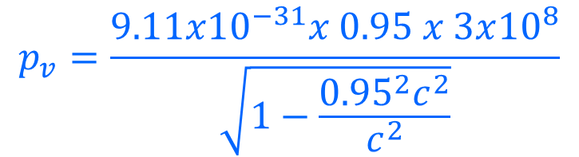



Example 1
An electron is placed into an electric field and accelerated to a velocity of 0.95c
Determine the relativistic momentum of the electron at this speed.
Compare this value with the predicted momentum using non relativistic momentum.
$$p_{v}=\frac{m_{0}v}{\sqrt{1−\frac{v^{2}}{c^{2}}}}$$
$$p_{v}=\frac{9.11x{10}^{−31}x 0.95 x 3x{10}^{8}}{\sqrt{1−\frac{{{0.95}^{2}c}^{2}}{c^{2}}}}$$
$$p_{v}=\frac{2.596x{10}^{−22}}{\sqrt{1−{0.95}^{2}}}$$
$$p_{v}=8.32x{10}^{−22} kg ms^{−1}$$

Slide 15




Example 1
An electron is placed into an electric field and accelerated to a velocity of 0.95c
Determine the relativistic momentum of the electron at this speed.
Compare this value with the predicted momentum using non relativistic momentum.
$$p_{v}=8.32x{10}^{−22} kg ms^{−1}$$
$$p_{v}=mv$$
$$p_{v}=9.11x{10}^{−31}x 0.95 x 3x{10}^{8}$$
$p_{v}=2.596x{10}^{−22}$ $kg ms^{−1}$
$Comparison \frac{8.32x{10}^{−22}}{2.596x{10}^{−22}}=3.20 x larger momentum at relativisitic speeds$

Slide 16
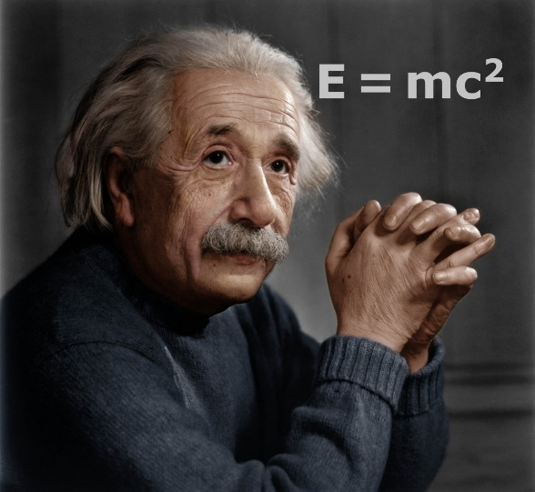
Energy – Mass Equivalence
One of the more interesting and famous areas of
Einstein's work, is the concept that mass and energy are equivalent.
Einstein described mass and energy as being different forms of the same thing, or as different sides of the same coin.
A piece of matter has an “energy of being” called its rest energy.
Einstein concluded that it takes energy to make mass and that energy is released when mass disappears.
Rest mass is, in effect, a kind of potential energy.

Slide 17
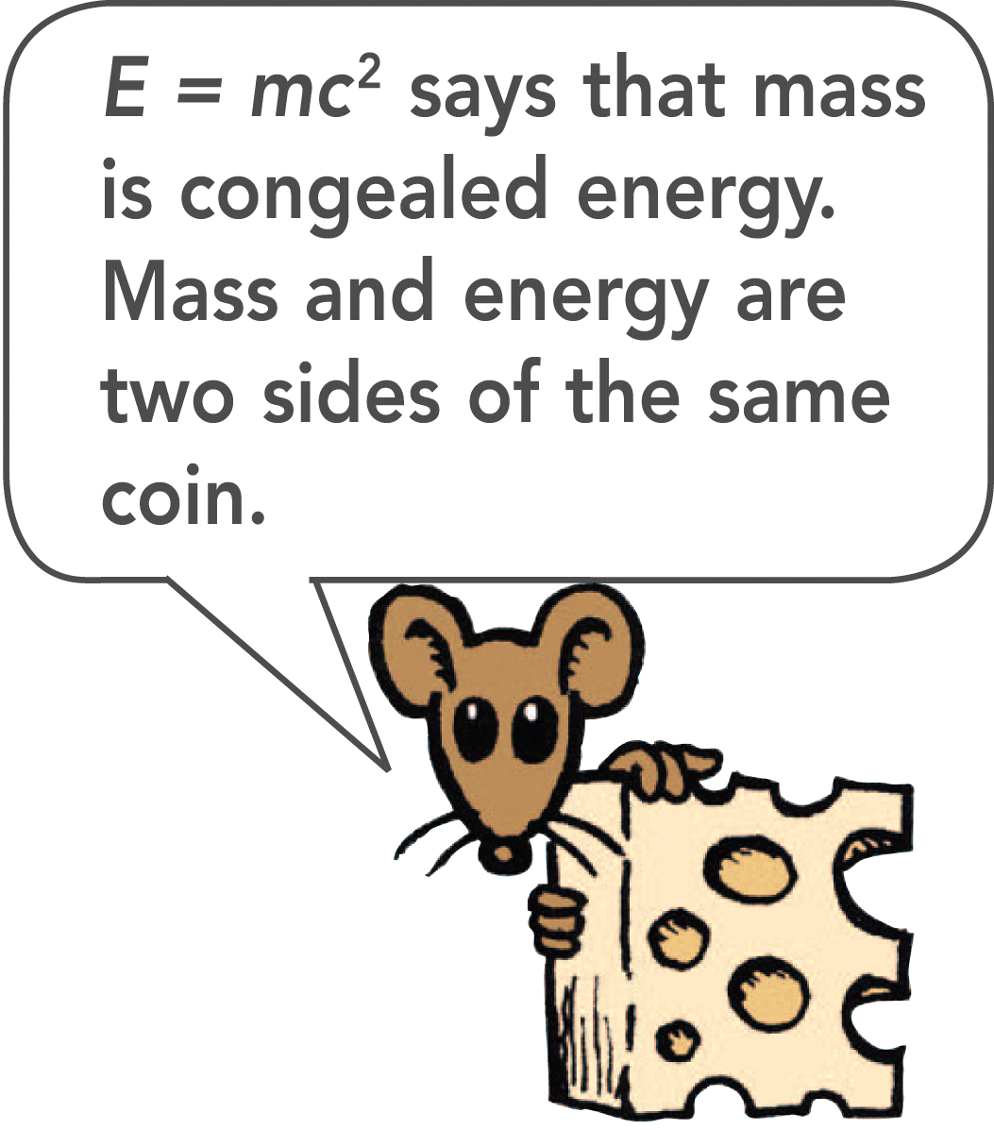
Energy – Mass Equivalence
The amount of rest energy E is related to the mass m
by the most celebrated equation of the twentieth century:
E = mc²
where c is again the speed of light.
This equation gives the total energy content of a piece of stationary matter of mass m.
The quantity c² is just a “conversion factor.” It converts the measurement of mass to the measurement of equivalent energy. It has nothing to do with light and nothing to do with motion.

Slide 18
Energy – Mass Equivalence
Rest energy can be converted to other forms.
For example, when we strike a match, a chemical reaction occurs and heat is released.
The molecules containing phosphorus in a match head rearrange themselves and combine with oxygen to form new molecules.
These molecules have very slightly less mass than the separate phosphorus- and oxygen-containing molecules by about one part in a billion.
For all chemical reactions that give off energy, there is a corresponding decrease in mass.

Slide 19
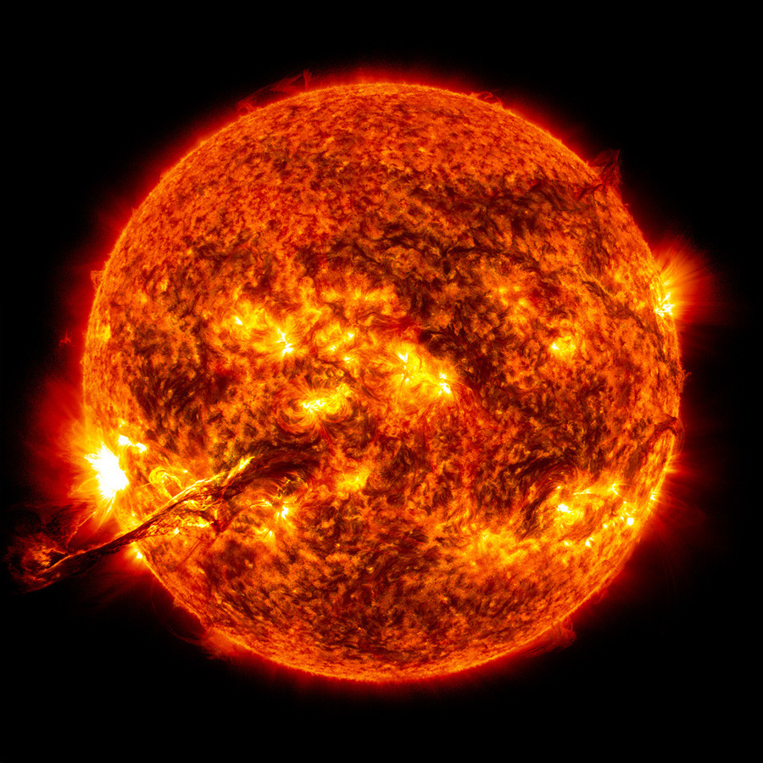
Energy – Mass Equivalence
More commonly we talk about rest mass to energy conversions in nuclear reactions.
For example, in one second, 4.5 million tons of rest mass is converted to radiant energy in the sun.
That is equivalent to 4.05 x 10²⁶ W

Slide 20
Energy – Mass Equivalence
In nuclear reactions, rest mass decreases by about 1 part in 1000.
The sun is so massive that in a million years only one ten-millionth of the sun’s rest mass will have been converted to radiant energy.
The present stage of thermonuclear fusion in the sun has been going on for the past 5 billion years, and there is sufficient hydrogen fuel for fusion to last another 5 billion years.

Slide 21
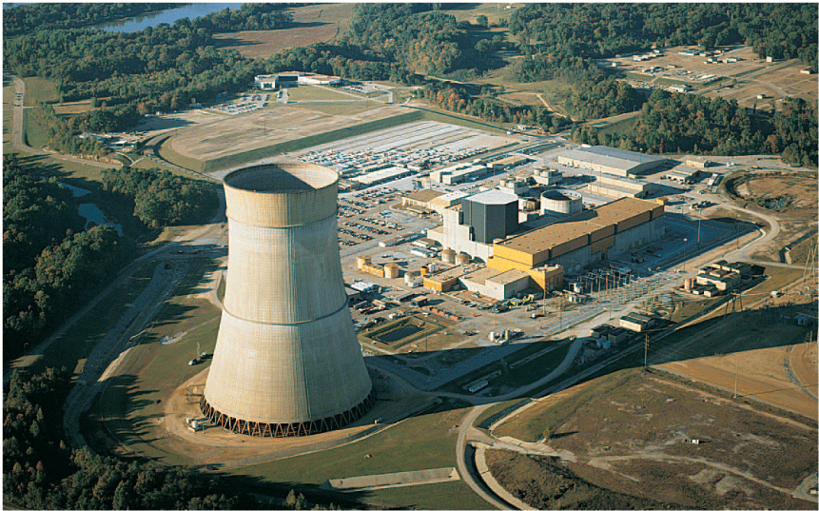
Energy – Mass Equivalence
Saying that a power plant delivers 90 million mega-joules of energy to its consumers is equivalent to saying that it delivers 1 gram of energy to its consumers, because mass and energy are equivalent.

Slide 22
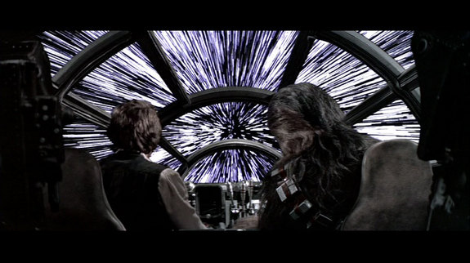
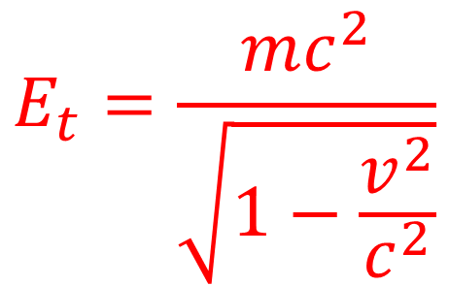
Energy – At relativistic speeds
We have already seen that momentum is dilated (increased) at relativistic speeds. We also saw that this meant a corresponding increase in relativistic mass. (not rest mass)
It then should follow that the total Energy of a particle was also increased by a similar transformation.
Einstein showed that total energy could be calculated as shown right:
$$E_{t}=\frac{mc^{2}}{\sqrt{1−\frac{v^{2}}{c^{2}}}}$$

Slide 23
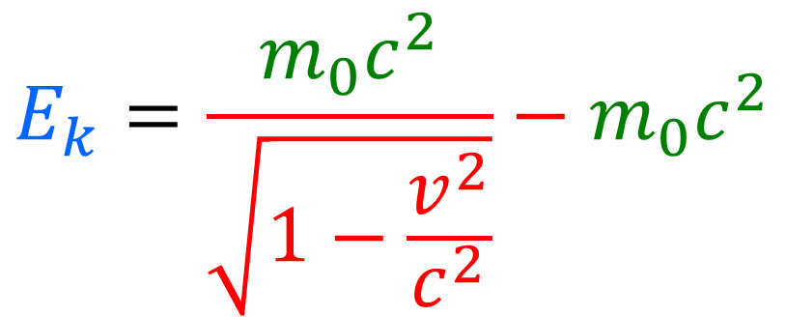
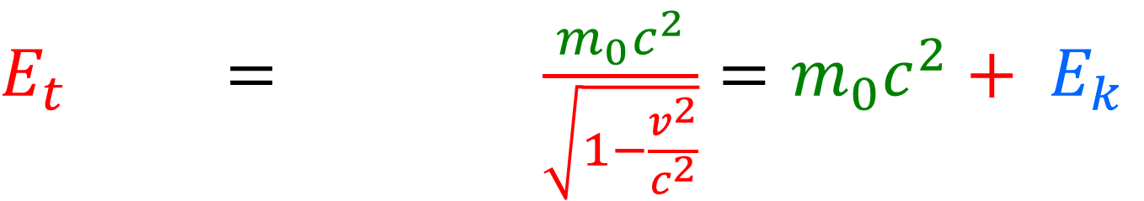
Energy – At relativistic speeds
Total energy includes the rest mass energy and the additional kinetic energy due to motion.
$E_{t} = \frac{m_{0}c^{2}}{\sqrt{1−\frac{v^{2}}{c^{2}}}}=m_{0}c^{2}+ E_{k}$
The relativistic kinetic energy equation shows that the energy of an object approaches infinity as the velocity approaches the speed of light. Thus it is impossible to accelerate an object across this boundary.
$$E_{k}=\frac{m_{0}c^{2}}{\sqrt{1−\frac{v^{2}}{c^{2}}}}−m_{0}c^{2}$$

Slide 24
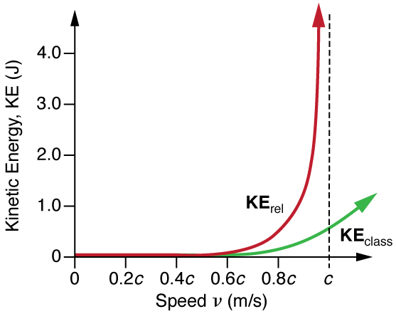
Newtonian Energy vs Einstein

Slide 25

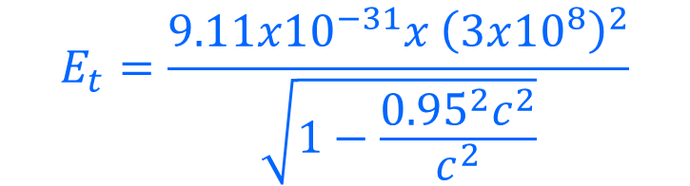

Example 2
An electron is placed into an electric field and accelerated to a velocity of 0.95c
Determine the relativistic energy of the electron at this speed.
Compare this value with the rest energy.
What is the kinetic energy of the electron at that speed?
$$E_{t}=\frac{m_{0}c^{2}}{\sqrt{1−\frac{v^{2}}{c^{2}}}}$$
$$E_{t}=\frac{9.11x{10}^{−31}x {\left(3x{10}^{8}\right)}^{2}}{\sqrt{1−\frac{{{0.95}^{2}c}^{2}}{c^{2}}}}$$
$$E_{t}=\frac{8.199x{10}^{−14}}{\sqrt{1−{0.95}^{2}}}$$
$$E_{t}=2.63x10^{−13}J$$

Slide 26

Example 2
An electron is placed into an electric field and accelerated to a velocity of 0.95c
Determine the relativistic energy of the electron at this speed.
Compare this value with the rest energy.
What is the kinetic energy of the electron at that speed?
Rest Energy
$$E_{t}=\frac{8.199x{10}^{−14}}{\sqrt{1−{0.95}^{2}}}$$
$$E_{t}=2.63x10^{−13}J$$
Relativistic Energy
$Comparison=\frac{2.63x10^{−13}J }{8.199x{10}^{−14}}$ = 3.20 times more energy

Slide 27
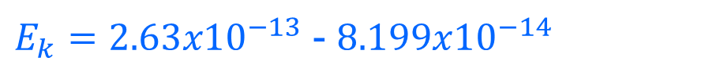
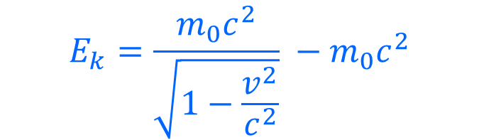
Example 2
An electron is placed into an electric field and accelerated to a velocity of 0.95c
Determine the relativistic energy of the electron at this speed.
Compare this value with the rest energy.
What is the kinetic energy of the electron at that speed?
$$E_{k}=\frac{m_{0}c^{2}}{\sqrt{1−\frac{v^{2}}{c^{2}}}} −m_{0}c^{2}$$
$E_{k}=2.63x10^{−13}$ - $8.199x{10}^{−14}$
$$E_{k}=1.81 x 10^{−13}J$$

